Slide 1
Waterway-sunrise-i_656B

Slide 2
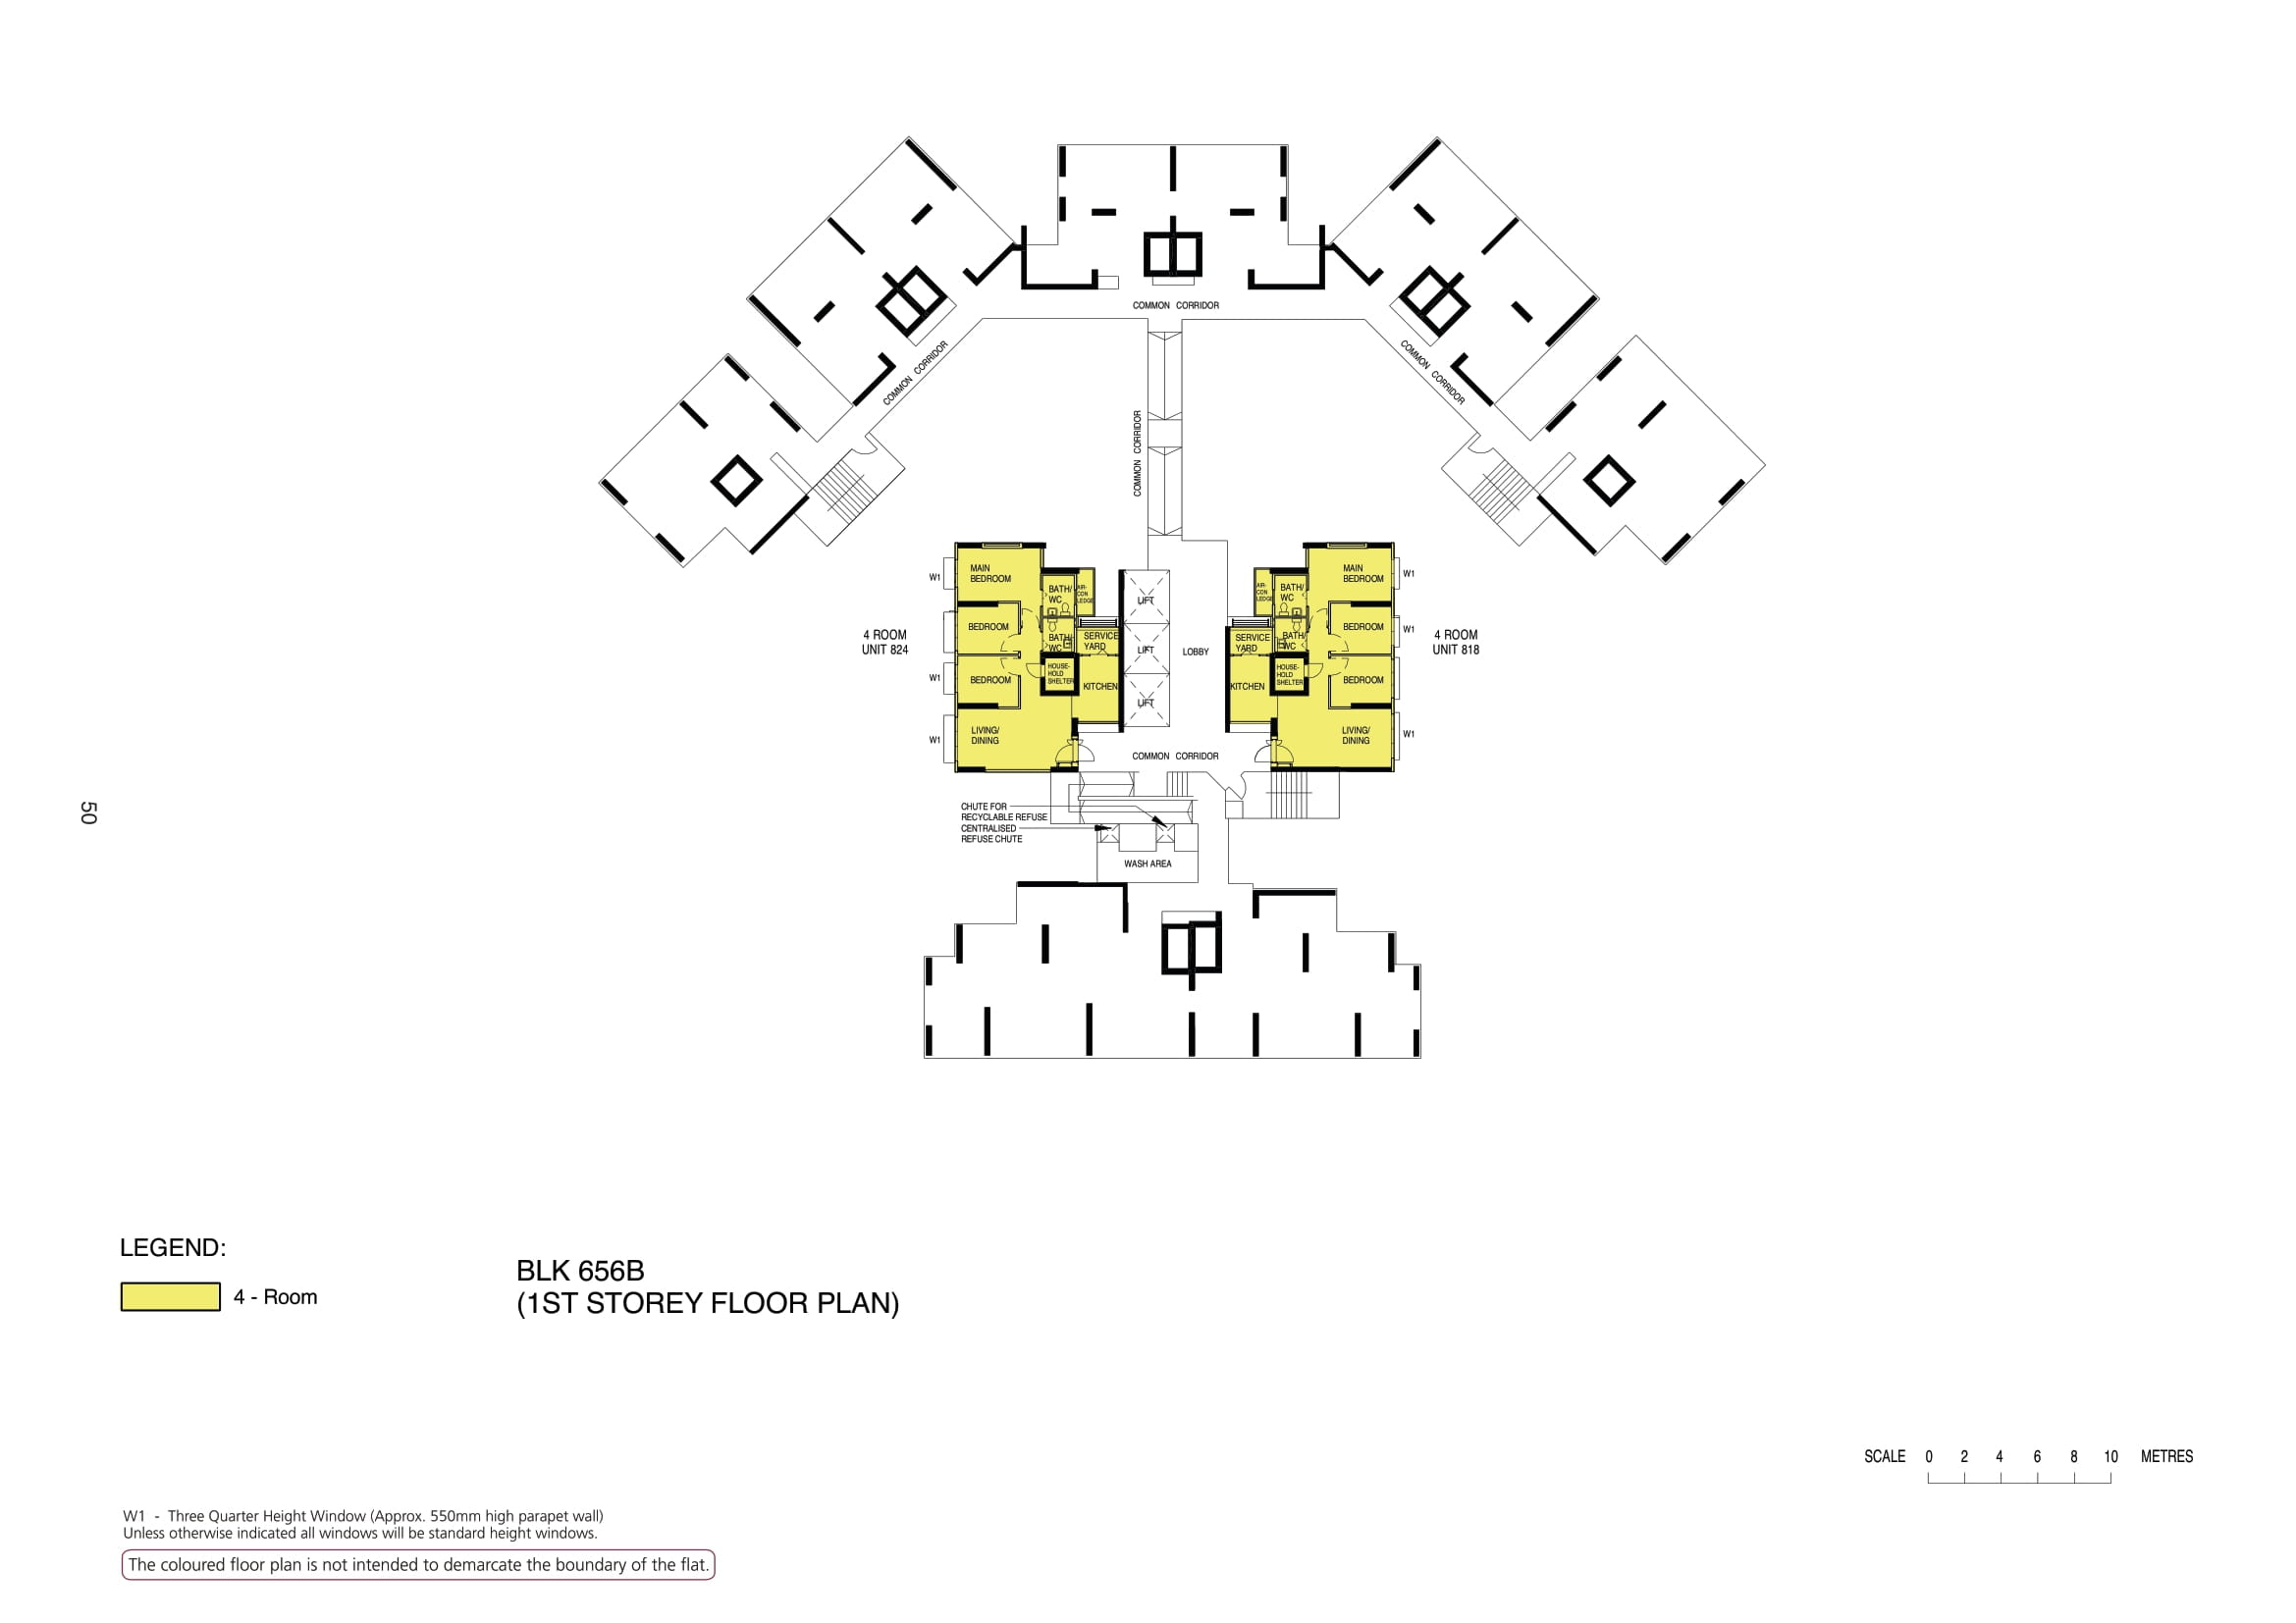

Slide 3
COMMON CORRIDOR
COMMON CORRIDOR
COMMON CORRIDOR
COMMON CORRIDOR
824
LOBBY
818
COMMON CORRIDOR
WASH AREA

Slide 4
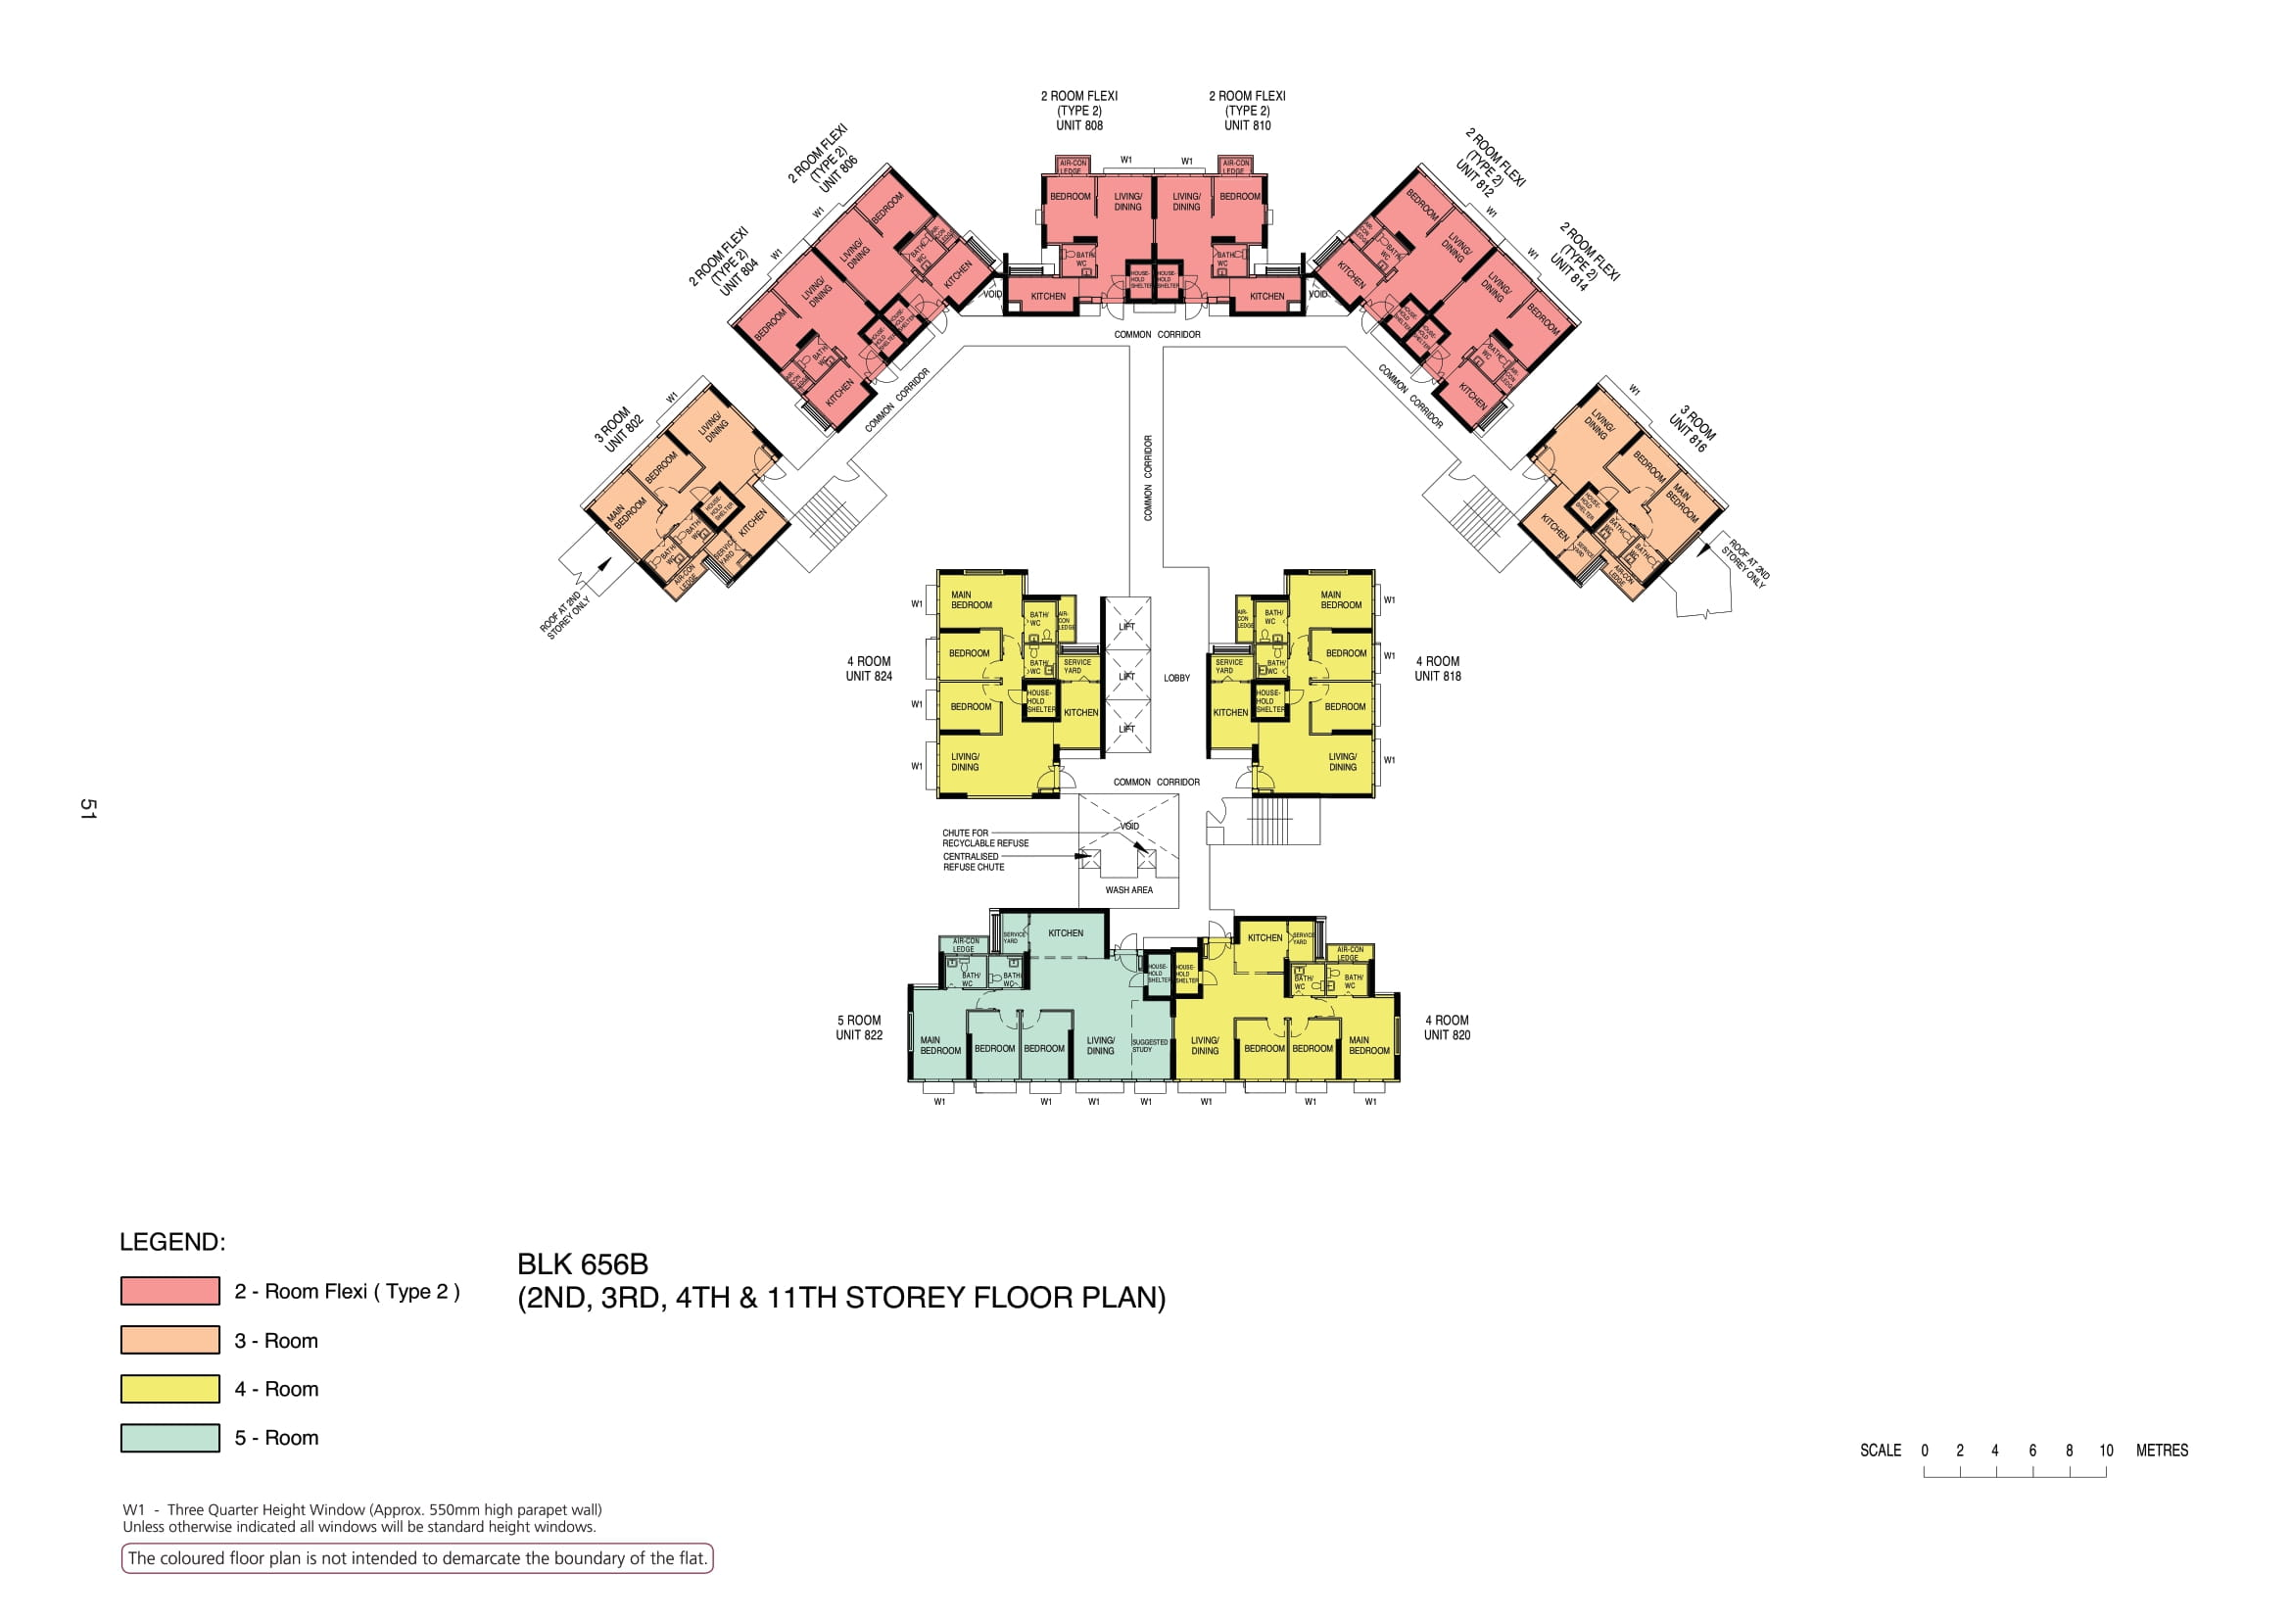

Slide 5
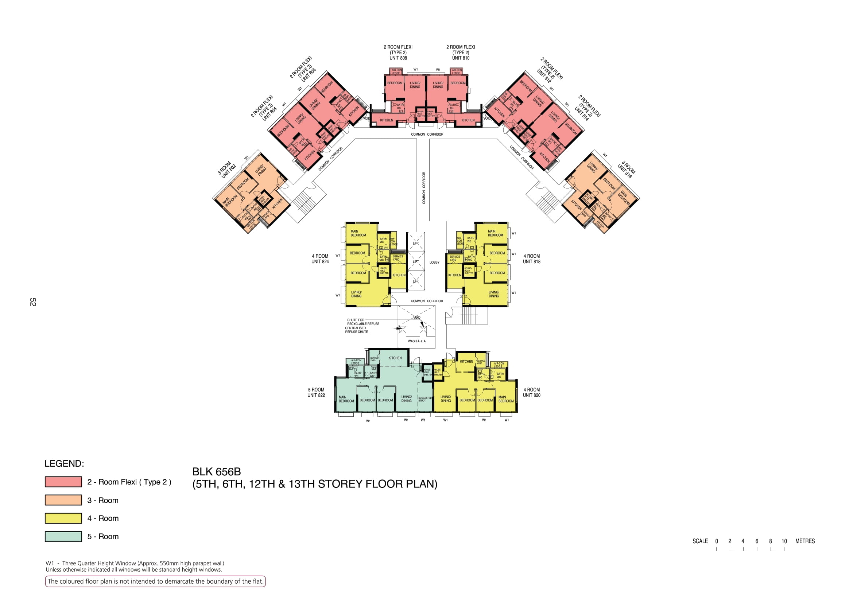

Slide 6


Slide 7
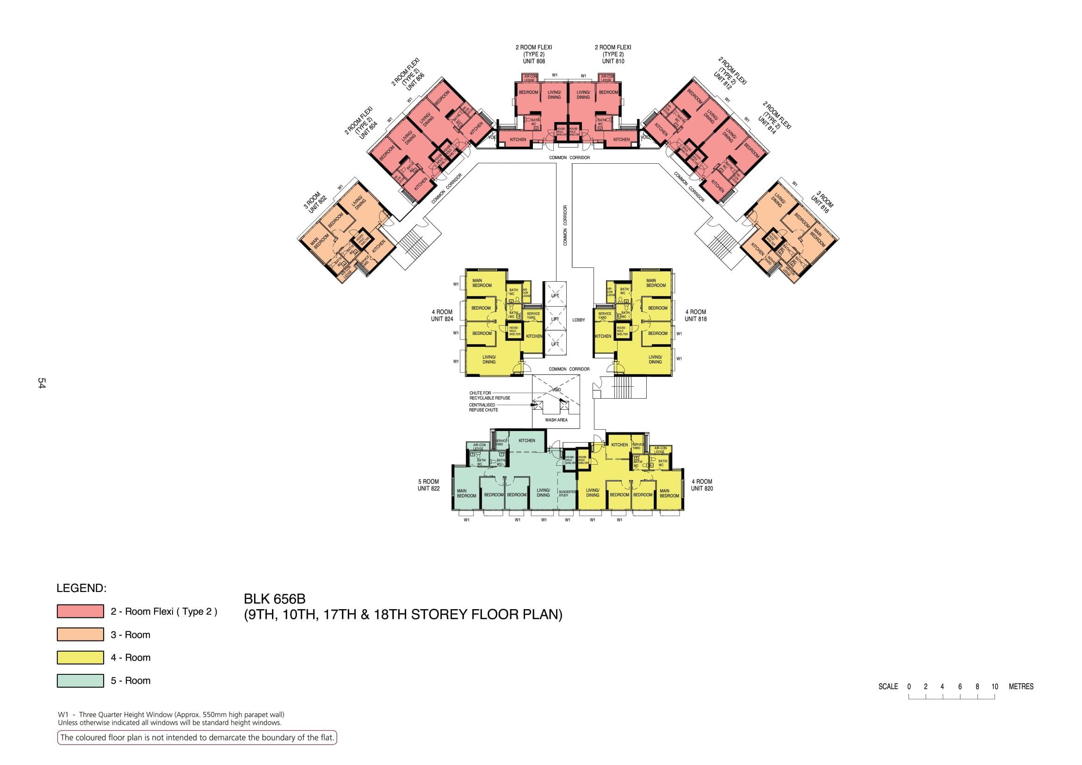

Slide 8
806
810
808
812
804
COMMON CORRIDOR
814
COMMON CORRIDOR
COMMON CORRIDOR
802
COMMON CORRIDOR
816
824
LOBBY
818
COMMON CORRIDOR
WASH AREA
822
820

